Slide 1
Credit Suisse - IMF
Performance, Scalability and Capacity Assessment
Aug 2017

Slide 2



Table of Contents
Background & Objective
Engagement Scope
Engagement Approach
Application Architecture and Key Issues
Analysis & Measurement
Tool Requirements
Deliverables
Assumptions
Dependencies
Support Requirements
Timelines & Resources
Roles and Responsibilities
Appendix – PACE Capability and Case Studies

Slide 3
Background and Objective
Background Inventory Management Foundation (IMF) is a Stock record application for Credit Suisse Front Office applications which consolidates inventory from different trading and order management systems, booking system and settlement systems at real time ( or near real time) basis. The data is then utilized by multiple downstream systems, currently by Securities Lending, collateral Management, Prime swaps and Prime Cash applications as well as by Prime Risk Management applications. Standalone Java processes process real time events from varied front / back office systems to create Positions that are stored in In-Memory Data Grid (Oracle Coherence). PB, PF and Risk systems then query the positions via load balanced Data Services (DS) instances (REST API). IMF Cluster has key components – Storage Nodes, SDU, IBP, OBP. IBP and OBP are cluster proxies for Feeders and DS respectively. The application has experienced Performance issues and System instability leading to total outages to business. The ‘Cluster Separation’ program has been undertaken to create smaller Clusters serving each of major business consumers – PF and PB. Benefits would be better isolation and improved stability due to smaller scale. CS requested Cognizant to execute performance testing of ‘Cluster Separation’ design starting 3rd week of August 2017.
Objectives and Outcome Engage with stakeholders to identify NFRs at each integration point- Volumetric details, SLAs, Throughput, Capacity, Availability, and Scalability Performance, Scalability and Availability analysis of new configuration and present findings in professional reports presentable to PS IT Head Identify design issues and bottlenecks, and suggest action plan to remediate issues. Templatize evaluation process for adhoc runs to be performed by team post engagement Cognizant Performance team proposes an approach with 2 tracks in parallel to ensure expedited and continuous recommendations that are implementable and provide quick benefits to Credit Susie Track I : Production Health Check focused on “As Is” health of the application and Root cause analysis of critical Historical issues Track II : Performance and Scalability Evaluation to ensure application handles current & future volume and load in UAT Environment. Total duration of the proposed engagement will be 12 weeks with both tracks being executed in parallel

Slide 4
Engagement Scope
Objectives
In Scope
Out of Scope
Assess Non Functional Requirements
Collect application business and technical NFRs and understand application architecture , end to end workflow
Understand collect information/ logs of recent production issues.
Implementation of assessment recommendations
Review of upstream/downstream systems
Review of third party external system interfaces
Review of process or standards
Any Product or Framework evaluation
Planning, preparation and execution of any functional / regression testing
Network latency optimisation
Actual Performance Testing and analysis of Feeders and down stream application is not in scope.
Performance and Scalability Assessments
Analyze production statistics and logs of recent issues for Performance, and Scalability bottlenecks
Identify set of performance tests to be executed on UAT to simulate mix of production load volume of feeder systems
Setup framework to enable IMF team repeat performance analysis post engagement
Availability and Resiliency
Review
Review application availability incidents in production and analyze root cause
Conduct SPOF/FMEA Analysis of IMF production Farm and assess health check from Resiliency perspective
Capacity Assessment
Capacity Analysis of IMF Production Cluster Farm for various workload scenarios
Provide recommendations for additional capacity, if required and its associated configurations
Present Performance , Scalability, Capacity and availability assessment report including observations, analysis findings and recommendations

Slide 5
Engagement Approach
Track I : Production Health / Historical Event Analysis
Track II : Performance & Scalability Load Testing and Engineering Approach
Week 1 to 12
Week 1 & 2 | Weeks 3 through 11 | Week 12
Gathering
Understand the problem statement in depth
Collect and validate NFRs
Understanding of system landscape, application architecture
Study existing monitoring setup and identify additional needs for Test environment
Instrument additional monitoring tools, attributes and logs as deemed necessary
Collect Key Performance indicators for analysis
Analysis
Analysis of the monitoring data collected and uncover top areas for performance bottlenecks
Gather data from various sources likes, SPLUNK and other sources.
Prioritize top performance Bottlenecks for deep dive analysis during track 2
Phases
Planning
Execution
Analysis
Recommendation
Iterative
Key activities
Verify Load simulation suite and CS Monitoring tools and logs in test environment
Verify/Build scenarios (fill gaps) to replicate the issue
Setup profiling tool in test/ lower environment
Deliver Engineering Plan with details for the subsequent phases of the engagement
Try replicating issue in Lower Env.
Perform Profiling and collect performance metrics
Execute different performance tests (Load and Scalability tests)
Collect performance test results and other metrics
Collate the results and observe for any abnormal pattern or behavior
Root cause analysis for top issues identified from health check
Analyze profiler data to determine hot spots
Usage and Throughput Trend analysis of monitoring metrics (Infrastructure resource usage, Oracle Coherence Cluster and Resource usage)
Scalability analysis and Indexing Strategy analysis
Bottleneck Identification & Root Cause Analysis
Solutions Identification
Develop recommendation Report
Short Term/Tactical Recommendations
Long Term/Strategic Recommendations
Implementation Roadmap
Deliverable
Engineering Plan
Intermediate Analysis Reports – Key Observations, Analysis & Recommendations
Recommendation Report

Slide 6
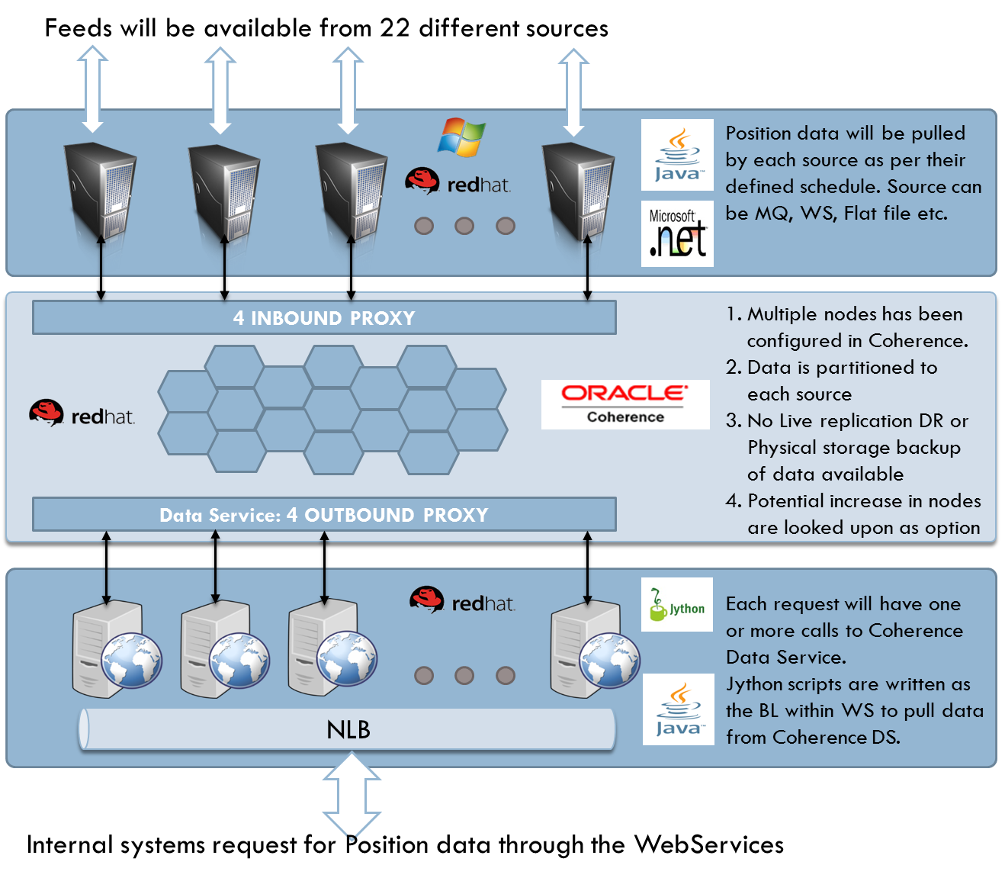
Our Understanding of IMF Application Architecture and Key Production Issues
Recent Key Production Issues
Application Architecture
Performance and Stability
IBPs intermittently fails or under stress when PSI bridge process huge volume of events via listeners attached to cache.
OBPs failures due to Etag invalidation or ‘heavy’ queries causing cpu spikes leading to Cluster instability.
Storage nodes failures due to rogue client connections with OBP.
SDU instability during reference data refreshes causing cluster instability.
Scalability:
Data Services current throttling configuration is based on trial and error which results in high CPU leading to Cluster instability.
Upstream systems
Inbound Proxy
Multiple Nodes have been Configured in Coherence.
Sybase DB is used for write back for reference data etc.
Sybase DB
Outbound Proxy
Infrastructure Configurations and Feeds
Memory Per Server: 196 GB
Number of Nodes by Type: 66 Storage, 6 IBP, 6 OBP, 6 DS.
Number of Nodes Per Server: 14 (+some utilities)
Cores Per Machine – 32 Cores
Cluster CPU Thresholds – 65% Utilization for Peak Volume
Feeder events: Peak 81mi, Avg 55 millions per day all
DS Query Volume: Peak 36k, Avg 25k per day all consumer
Regional Load Balancer

Slide 7


Analysis & Measurement
Coherence Metrics
Total Duration – 4 weeks
Cluster, DS Metrics
Components
Coherence – JAVA API
Attributes
No. of Calls (GET and PUT)
Get() and put() response times
Resource utilization(Memory, CPU)
Components
Profiler statistics(JVM Profiling)
Attributes
Response time and Throughput
Scalability characteristics
Resource Utilization
Cache/Requests/Session /Transaction statistics
GC analysis, Thread pool size, connection pool
Analyze
Data &
Database
Analyze
Application
Analysis
Analyze
Network
Analyze Platforms (HW and OS)
Platform Metrics
Network Metrics
Components
Traffic between Feeders, Input & Output proxies and Data services
Attributes
Load balancing
Bytes transferred
Connection failures
Bandwidth utilization
Transmission errors
Components
Web Server
Operating System hosting all servers
Attributes
Resource utilization like CPU. Memory, Disk l/O, Context Switching, etc.
Socket Buffer size
Note: The above list is indicative, Comprehensive list of attributes will be identified during execution.

Slide 8
Tool Requirements
Analysis Focus Area | Tool / Report Name | Tool Type
Load Simulation | LoadRunner* /in-house scripts or tools | Commercial
Red Hat Linux | Vmstat, IOstat, Netstat, Nmon,SySstat | Native
Oracle Coherence Monitoring & JVM | Platform provided Monitoring, JProfiler | Native / Commercial
Network Monitoring | Native Tools/Datagram Utility | Open Source
Logs at various components | Splunk | Commercial
Note:
Any existing APM type tools available in CS will be leveraged for analysis.
* Need and availability of Load Runner for load simulation will be confirmed during Site Audit phase.

Slide 9
Deliverables
Deliverable | Description
Weekly Status Report (Weeks 1-12) And Daily Stand up updates of Status | Site Audit (by end of 1st week) Weekly Progress updates Plan for next week Key observations, hotspots Issues & Dependencies
Interim Report (after 6 Weeks) | Key interim observations from the ongoing analysis: Server health analysis Performance slowness deep dive Coherence metrics analyzed. Provide recommendations for identified performance issues/risks identified in deployment configurations, integration architecture Provide implementation roadmap as short/long term recommendations
Assessment Report (Week 12) | Assessment report for Performance Issues. Salability report Capacity Assessment and Recommendations Provide recommendations for identified performance issues/risks identified in deployment configurations, integration architecture etc.

Slide 10
Assumptions
Category | Key Assumptions
Effort Estimate & Project Schedule | Effort estimate is based on the current understanding of the requirements. Any extension or change in scope will be accommodated through a CR process agreed up on by both Cognizant and Credit Suisse Estimated Efforts will be validated during planning phase of engagement Currently top 3 historical issues are considered for production metrics assessments
Infrastructure | CS will provide desktop/laptop, LAN ID to access network and required licenses to tools CS will set up all the required access before starting of the discovery phase. CS will provide necessary approvals to use any Cognizant proprietary tools
Support & Availability of CS resources | CS will ensure following key stakeholders available during the assessment – Single Point of Contact (PM), Business Analyst, Enterprise & Application Architects, Development Lead, QA Performance Test Leads, Infrastructure Support
Business Analyst | Non-Functional requirements and critical transaction details will be provided
Enterprise & Application Architects | End-End deployment architecture & design details and known architecture risks/limitations will be given Non-Functional requirements for peak load conditions will be provided Critical components in the deployment and configuration details will be provided

Slide 11
Dependency with Credit Suisse
Category | Key Assumptions
Environment | CS will provide a “Prod-like” environment for issues replication. The environment can be a horizontally scaled down version of Prod. During the exercise of replication of Performance issues, the environment should be available exclusively for the activity.
Tools | CS will provide access to SPLUNK and other monitoring instrumentation available. Wherever instrumentation is not setup already, access to execute native Linux commands should be provided. CS will provide Cognizant consultants necessary access and permission to the production and test areas of applications to monitor and measure performance related information. If required, necessary access privileges (VPN, Login user Ids to the Remote Desktop) will be provided to configure monitoring tools.
Documents | CS will provide necessary access to applications Deployment Architecture, HLD/LLD Document databases/data, documents, reports and environments
Performance Results and Test Data | CS will provide the required Dump of SQL Queries and the test data within for any load simulation that may be required for Oracle Coherence. Credit Suisse to share historical/logs data about performance, profiling etc. during the Analysis phase.

Slide 12
Support Requirements
Stakeholders | Activity | Mode of Communication | Total Duration in hours | What is Expected
Senior Management | Project Kickoff Meeting | Meeting | 8 | Define objectives, scope, set expectations
 | Final Presentation | Meeting/ Discussions | 2 | Feedback on the recommendation Future course of action
Application Coordinator | Coordination | Meeting / Discussion | (1 or 2 hours per day) | Coordinate with Cognizant Team Issue Resolution Organize meetings / discussion with other team(s)
Application & Business SMEs | Project Kickoff Meeting | Meeting | 1 | Define objectives, scope, set expectations
 | Business analysis | Discussions / Meeting | 6 (per week) | Provide business drivers, Performance, Scalability and Availability SLAs Details about business growth plan
 | Final Presentation | Meeting | 2 | Feedback on the recommendation
System / Operations group | System Study | Discussion / Document / email | 16 | Provide details of application Hardware, Software, Network, etc. Provide catalog of each server (software, version, patches, configuration etc.) Details about maintenance schedule, backup, down time, etc. Provide performance logs, utilization details, server logs etc.
 | System Administration | Hands-on | 8 | Provide access rights to the environments Enabling system logs
Development team, Architect, DBA team | System study | Discussion / Document / email | 1-2 hour/day | Help in understanding the application architecture, design Provide the architecture, design and deployment documentation
 | Status meeting | Meeting | 2 (Every Week) | Provide any details required during the course of the engagement and feedback
Support hours requested are indicative for planning purpose and any additional meeting will be scheduled with prior notification

Slide 13
Timeline & Resources
Phases | Week 1 | Week 2 | Week 3 | Week 4 | Week 5 | Week 6 | Week 7 | Week 8 | Week 9 | Week 10 | Week 11 | Week 12
Planning & Gathering
Execution & Measurement (Iterative)
Analysis (Iterative)
Testing & Capacity Assessment
Recommend & Report
Offshore – Lead Performance Architect (P & S) | 1 | 1 | 1 | 1 | 1 | 1 | 1 | 1 | 1 | 1 | 1 | 1
Offshore - Performance Architect (P & S) | 1 | 1 | 1 | 1 | 1 | 1 | 1 | 1 | 1 | 1 | 1 | 1
Offshore - Performance Test and Capacity Engineer |  |  |  | 1 | 1 | 1 | 1 | 1 | 1 | 1
Estimates:
Cognizant proposes Fixed Cost of $46308 for above schedule with Managed services.
Any changes in scope or delays beyond control of Cognizant would impact the overall costs. Based on the impact of the changes, additional charges may apply. This would be discussed with Credit Suisse and actioned appropriately through a CR.

Slide 14
Roles and Responsibilities
Role | Responsibility
Lead Performance Architect | Drive the workshops and meetings with the stakeholders Responsible to identify the use cases [critical transactions] Present the Performance and Scalability recommendations to the stakeholders and solicit relevant buy-in Understand the release changes, critical transactions & processing schedules, non-functional requirements(NFR)/SLA Understand overall deployment architecture and monitoring set up Conduct NFR elicitation/review meetings with Business Analyst, Enterprise & Application Architects Conduct Root Cause Analysis of Historical Issues
Performance and Scalability Architect | Understand Functional Landscape Business drivers Deep Dive in production issues and Log Analysis using SPLUNK Gather & assess existing performance test results for the given performance NFRs & any hotspots in configurations Assess the open performance defects/risks and planned mitigations Conduct Root Cause Analysis of Historical Issues
Performance Test and Capacity Engineer | Understand the critical transactions & processing schedules, non-functional requirements(NFR)/SLA Assess performance test strategy and environments Assess key non-functional tests executed including performance testing, failover tests Device the load test simulation suite. Assess the open performance defects/risks and planned mitigations Execute Performance Test and collect Performance Test result analysis Conduct correlation with Test results and analyze to identification of Root causes Perform Capacity analysis and provide recommendations

Slide 15
Sajeesh Nair – Performance and Scalability Architect
Overview | Expertise | History of Key Assignments
Sajeesh Nair Performance Architect Executive Summary 12+ years of IT experience in Performance Engineering, Design, Development, Performance optimization, Scalability and Capacity planning of large enterprise applications. Specialized in Mobile and Web Applications performance monitoring, analysis and tuning. Good knowledge in monitoring resource utilization and dynamic profiling of various environments across Enterprise wide applications and Optimized Resource utilization and application code to achieve high performance and scalability Experience in In-Memory DB, WebServices | Performance Engineering Capacity assessment Complex Web applications performance monitoring, analysis and tuning Scalability and health assessment of applications across various platform Profiling Tools JProfiler dotTrace SQL Profiler Monitoring/Measuring Tools OS Native Tools Dynatrace, AppDynamics Splunk Mobile Native Education Bachelor of Engineering in Information Technology | Leading Bank in Europe/Netherlands - Performance, scalability and stability analysis of CIO sponsored critical application. End to End performance analysis in SOS mode to improve response times by 5x. Life Science Collaboration Platform Product Development - Performance Engineering of a Life Science Product, to provide tuning recommendations, at Architecture/Design, Code, Configuration levels. Provide End to End Performance Strategy from NFRs to Go Live. Leading Insurance Provide in US – Setup and lead Performance Engineering COE for the Digital Marketing organization. Ensure Performance and Availability for various products, provide solution/architecture recommendations, performance validation strategies, driving issues troubleshooting etc.

Slide 16
Kalyan Dhokte – Lead Performance and Scalability Architect
Overview | Expertise | Examples of Recent Projects
Kalyan Dhokte Principle Architect – Performance Engineering Executive Summary 19+ years of experience in in IT consulting Performance and resiliency engineering Capacity Planning and Data center Transformations Prior Experience Worked as Senior Solution and Performance Architect and in Advisory Role for various Banking, Manufacturing and Telecom Customers Executed more than Twenty Five IT consulting assignments in Enterprise application assessment, IT Architecture, Performance Engineering, Testing, Tuning and benchmarking of the Enterprise systems, Databases, Capacity Planning and Hardware Sizing Experience in Java ,.NET, Oracle Technology Stack Oracle Coherence and Web services using Spring boot, Node JS and REST APIs | High Availability Resiliency Engineering Performance Engineering Application Scalability Assessment Performance Tuning and Benchmarking Capacity Planning Business continuity NFR Risk assessment | Enterprise architecture review, application performance assessment, hardware sizing, and for banking customers. End to end Performance and High Availability consulting, tuning & benchmarking of the enterprise systems assignments for leading European Banking Customer NFR Consulting, Risk assessment and Remediation Architecting and Blueprinting of Performance Engineering Solutions Managed Performance Centre of Excellence for Banking and Manufacturing Customers High Availability and Resiliency assessment for Databases, Web Servers, Middleware, Storage, Networks and provide remediation strategies with consultative solutions and delivery support

Slide 17
Gaurav Arya – Performance Test Architect
Overview | Expertise | History of Key Assignments
Gaurav Arya Performance Engineering Architect Executive Summary 11+ years of IT experience in Performance Engineering, Performance Testing and Capacity planning of large scale OLTP applications. Experience in Java, Oracle and REST API Web services Specialized in Web based Applications performance testing. monitoring, analysis and tuning. Vast experience in performance testing and engineering initiatives of extremely large scale application (millions transactions per day ) with large data volumes (~100 TB). | Performance engineering and Performance Testing Capacity assessment and capacity planning Application code review. Production Issue analysis. Scalability and health assessment of applications across various platform Profiling Tools Jprobe NewRelic Yslow Pagespeed Monitoring/Measuring Tools OS Native Tools Dynatrace, NewRelic Sitescope Certifications Sun Certified Java Professional Education Bachelor of Engineering in Electronics & Communication | Fortune seven company based out of Woonsocket, RI– Identify potential causes that impacts couple of business critical application‘s stability and provide roadmap to improve resiliency of the applications in the portfolio Large insurance service provider based out of Boston, MA– Production issue analysis. Root cause analysis of production performance issues provided recommendation to resolve performance issues. Product based company based out of NJ, USA – Align Performance Testing and Engineering methodology along with their Product Development Life Cycle (PDLC) to certify their applications for Performance.

Slide 18
Thank You

Slide 19









PACE Overview
Delivers innovative services in managing Non-Functional Requirements(NFR’s) that help customers drive better value for their businesses
POWER TO PERFORM
6
3
15
7
We work with
9 of the Top 20 Fortune 500 Companies
Out of Top 10 Healthcare & Pharma
Out of Top 5 BFSI
Out of Top 25
P&R
Out of Top 10 CIMET
Performance
Scalability
Mobile
Internet Of Things (IoT)
Cloud
Technology Expertise
Offer Services to Address
Social
Analytics
SAP
Capacity
Resilience
Oracle Ebiz
DW, ETL
.Net, J2EE
COMPETENCIES
330+
KEY DIFFERENTIATORS
Pioneer in PE
First in the industry to have comprehensive Resilience Engineering services
Seasoned performance Architects and Consultants
185+
Active clients across various domains
Digital Focus
Transform business by embracing technologies like IoT, Big data & Analytics
15
Years of experience in Performance and Scalability Engineering
10+
Proprietary Tools and Accelerators
Single Point
Cost-Effective Solution
A vendor neutral / technology neutral and domain agnostic group providing end-end services.
GLOBAL OPERATIONS
SERVICE CATALOGUE
Performance Engineering
Capacity &
Application Performance
Resilience Engineering
NA: 25%, CE+UK: 10%, and APAC: 65%
Digital - User Experience Engineering
PACE Consulting
Cloud Cirrus
Notes:
Improving Business outcomes through proprietary and mature processes
More than 1000 projects executed, with over 300 SOS projects
24+ accounts, where PACE is the door opener for the account
1300 person years of overall experience
NA+UK: 93%, CE: 3.5%, and APAC: 3.5%

Slide 20






PACE Service Catalog
Provides Scalability and Resiliency to applications deployed on Cloud
Proactively addresses application NFR’s or reactively covers both app & infra stack
Performance Engineering Services (PES)
Cloud Cirrus
Uplift an enterprise’s performance engineering maturity and competency to Best in Class (BIC)
Application Performance and Capacity Management Services
Service Catalogue
Capacity &
Application Performance Services (CAPS)
PACE Consulting
Digital - User Experience Engineering
(UxE)
Resilience Engineering Services (RES)
Ensures business continuity even during sub-system / component failures
Drive ‘User Centric’ NFRs that are more prevalent for Digital implementations

Slide 21
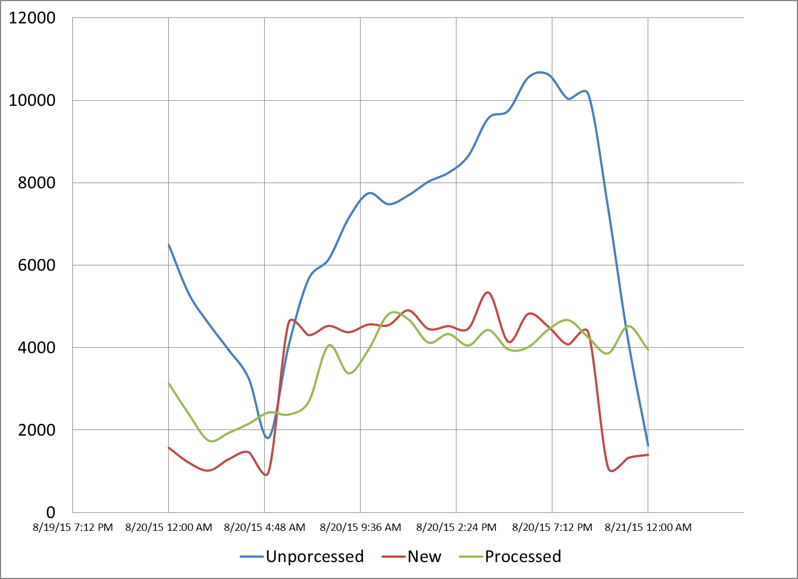
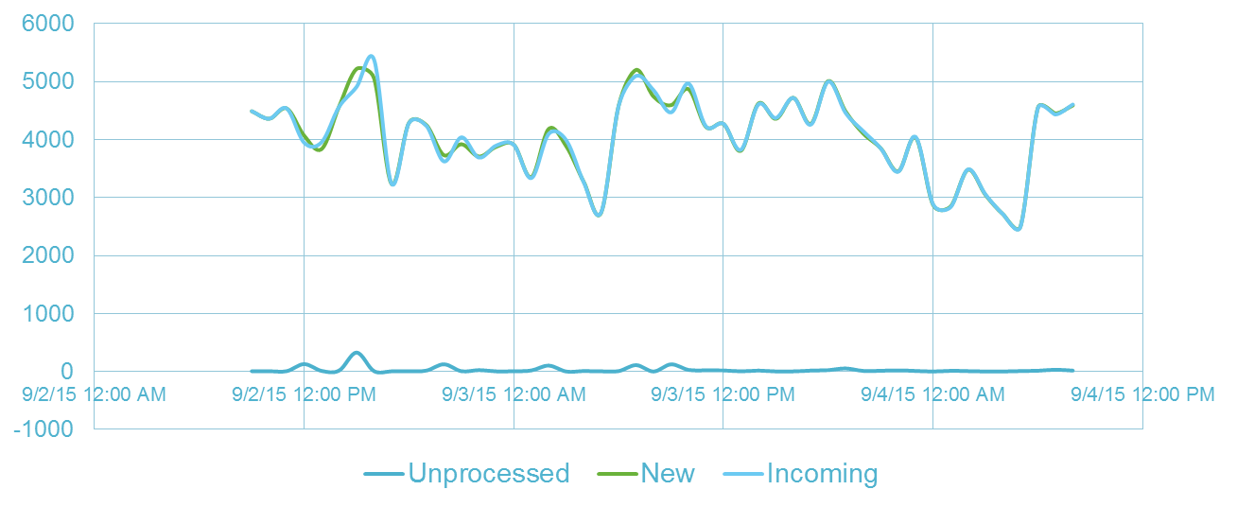
Case Study1 : Production Performance Optimization
Client: International diversified corporate group with direct distribution of various products like household appliances, fitted kitchens or cosmetics
Before Optimization
After Optimization
Challenges:
As the production lines were increased, one of the critical applications that supports SCM had SLA misses to process 5K messages/hour
Business is expected grow 5 times resulting in 20K messages/hour
To Scale the application to handle 20+K messages/hour with “Unprocessed queue length” < 500 messages
Unprocessed messages peaked to > 10K
Unprocessed messages < 50
Solution
Cognizant’s PACE team, analyzed performance issues & identified configuration parameters playing a vital role in intermittent performance slowness
Recommended configurable parallelism technique with multiple queues which can scale dynamically as the production lines were introduced as strategic long term solution
Impact
Parallelism significantly improved the throughput to achieve 9K messages / hour / queue
Achieved 20K+ messages throughput with just 3 Queues
No Additional Hardware was added
Notes:
Cognizant took over data center maintenance and migrated the applications into cognizant owned environment as part of maintenance and support

Slide 22
Case Study2 : APM RCA Service for a large US Insurance Company
The Requirements
Customer’s production support teams spend lot of time in war room calls to perform RCA on production incidents
Customer wanted to setup a centralized Service Design team to effectively handle the availability/ performance issues for all the critical applications in production
Cognizant’s Solution
Cognizant formed a team with the objective to focus on following areas
Pro-active assessments to
Improve Online Availability
Improve Batch SLA compliance for critical batches
CPU / MIPS Optimization for Mainframes applications
Effective Incident management
Tools Leveraged
Key Touch Points
Accomplishments (1 Yr Period)
CA Wily APM
IBM’s Support Assistant, Thread dump analyzer, GC analyzer
Eclipse Memory analyzer tool
Cognizant’s Analyzer tool
INSIGHT for DB2
STROBE
Incident Management Team
Application Development Team
Capacity & Performance Management Team
Executive Leadership
Improved the availability of 13 critical online applications from 97% to 99.9%
Over 10 critical batch schedules have been optimized and batch execution improvements are in the range of 22% to 63%
Saved over USD 2M by optimizing the MIPS for the mainframes applications
Established a well-defined process for conducting RCA for any production incident on performance / availability and thereby reduced the turn around time
Resolved all production issues (~5 / month) on availability / performance within P1 SLA timelines

